Slide 2
Tuesday morning workshop session Drilling in a harsh polar environment: sea ice, icebergs and weather assessment; planning for the unexpected.
Can divide this problem into three parts:
Past seasonal variability (monthly and daily) – for expedition planning.
Daily monitoring at sea – for at-sea decision-making.
Forecasts – for at-sea decision-making.
Hazards:
Weather (low temperature, high wind, icing)
Sea state (wave height)
Sea ice
Icebergs

Slide 3
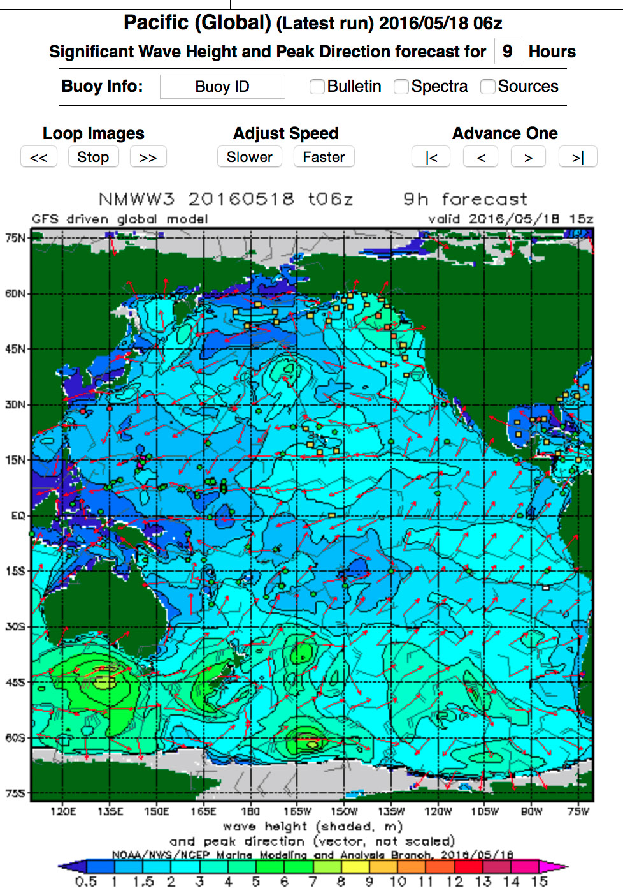
Sea State
NOAA Wavewatch Viewer III
http://polar.ncep.noaa.gov/waves/viewer.shtml

